Slide 1
Awesome board games assignment
Part 2 : Mockups
Abhinav Jain | 9818274986

Slide 2
Basic feature set for phase 1 (From the previous slides)
Supply side features
Create listings for inviting people to their homes
Ability to create a listing – two options :- ability to auto approve any request, or wait for an approval before confirming a booking.
Ability to chat with people who requested a booking.
Create listings for board games to be borrowed
Not the primary use case. For now the features will be implemented by a simple CSV upload. Only seeded listing from Awesome board company will be showcased.
Demand side features
Ability to search for board games (Filters : Map, Game Category, Age Bracket)
Ability to search for invites. Generate a booking request. View status of the booking request. Chat with the host. Make payment.
Review the experience and a host
Raise a customer support ticket
Ability to participate in local competitions verified by Awesome board games and earn points based on the number of wins.
Ability to refer a listing to a friend / group of friends.
Platform features
Identity : Important for building trust. Also needed for gamification.
Verification flow : Phone number, Email, Facebook profile etc.
Payment mechanism
Ability to rate a person based on hosting experience.
Gamification : Provide badges based on specific board games and overall involvement in the community. (E.g. The Chess Guru, Strategy King etc)
Increasing engagement : Ability to send push notifications

Slide 3
Booking(Detail)
Details
Conversations
Profile Screen
Badges
Average review
Verified profile
Notification Screen
Overview of all the notifications
Types of notifications
Different handlers for different notification type
Give an option of Signup/Login/Forgot password etc in case the customer is creating a profile for the first time.
Bookings
View my bookings
(Different tabs)
Requests
List all booking requests
(Different tabs)
Home Screen
Choose search type (Borrow games,Events)
Access Drawer
Important updates
Notification center
Profile
Events Search Page
Default search parameters applied
Ability to order by parameters
Map view
Filters
(Drawer Elements)
Profile (and summary)
(Borrow | Matches)
Booking requests
(Borrow | Matches)
Share
Rate the app
Terms and conditions
Request (Detail)
Details
Process and the current status
Conversations and chats
Take actions
Events Details Page
(Details)
Borrow Search Page
Default search parameters applied
Allow search for specific instances
Order by prices, nearby
Confirmation Page
Default search parameters applied
Ability to order by parameters
Map view
Filters
Updates on the home screen :-
Acceptances of interests
Offers (Item that you have been requesting for)
Notifications on local competitions etc
New blog entries
Borrow – Detail Page
See the terms and conditions. Show option of being able to request for booking.
Notes :
The above flow shows only the basic user flows.
User app (Overview)

Slide 4
wireframes

Slide 5
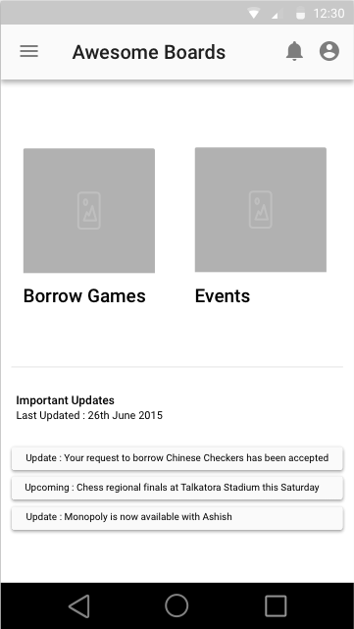
Home Screen
Quick access to important notifications
Access to drawers
Quick access to profile page
Search for games that can be borrowed
Search for events
Possible updates on the home screen :-
Acceptances of interests
Offers (Item that you have been requesting for)
Notifications on local competitions etc
New blog entries

Slide 6
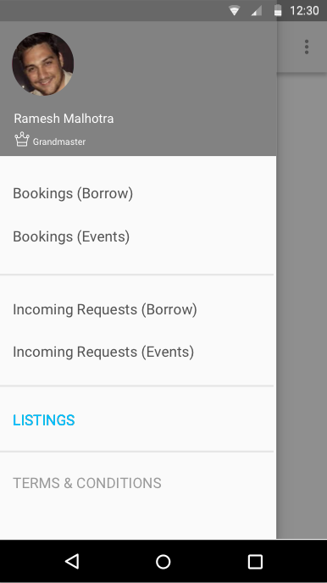
Home Screen Drawer
(Logged-in user)
Can introduce some gamification elements to drive customer engagement
View status or current and previous booking requests for borrowing board games or take part in events.
Take actions on the requests that other people have raised.
Manage listings (put up board-games on the website that other people can borrow or host events at home)

Slide 7
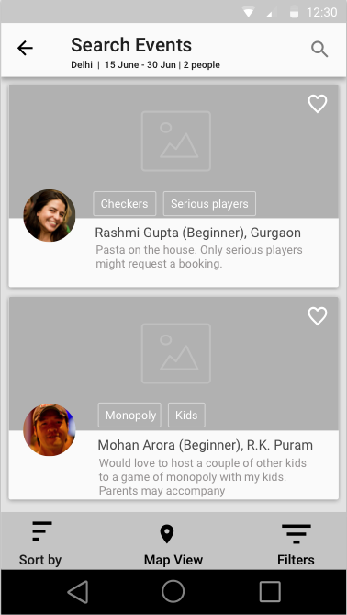
Events search page
(Cards interface)
The default search is for the next 15 days. Location is detected from the device.
Search parameters can be modified. Geography, dates and number of people
Tags allows for quick search
Users can add a card to favorites which will be accessed in the profile section
Advanced filters
Age group
Board game
Game category
Ratings
Sub-Locations
Sorting options
Distance
Rating
Dates

Slide 8
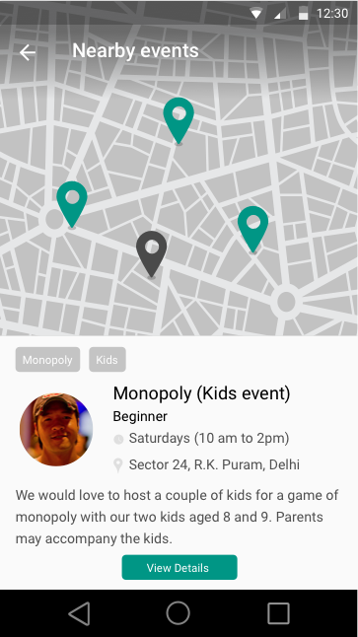
Map based events search
The pin locations show the different places of hosting events. The users gets to the screen on clicking the maps tab on the search page. The filters applied on the search page would be effective on this page as well.
The pop-up appears when a particular location is selected.
The details view is visible once the user pulls the details from the summary sheet (Similar to google maps)
User can click on the events page to view the details

Slide 9
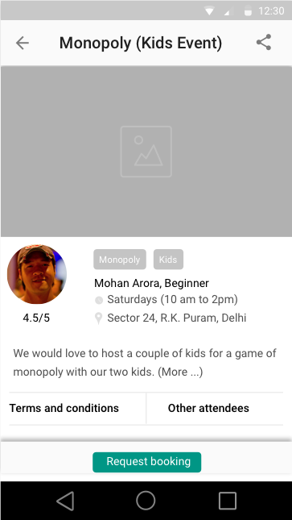
Event details page
One can share the event with friends
Rating as a host
View all details of the event
This section does not move
A user can request for a booking in case auto-approval is not ON.

Slide 10
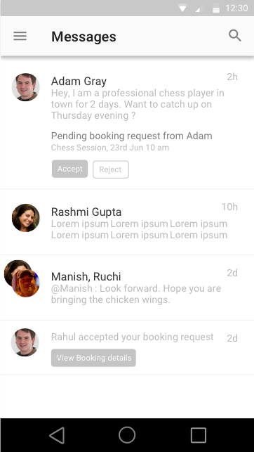
Messages Panel
Ability to search for previous messages
Options of being able to take quick actions from the summary page itself.
Can have threads (with multiple participants) to discuss the logistics of a particular event.
Notifications of pending and new requests
Smart buttons that are context aware. E.g. Link to the booking details page when a request is accepted.

Slide 11
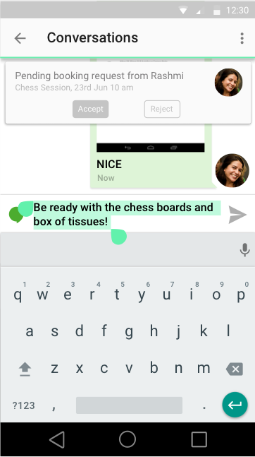
Messages conversation
Settings to be able to see action cards or not. Can also be used to add more people to the conversation.
Context aware cards. E.g. in this case, the card gives the user an option to be able to accept the booking request from within the chat window itself.
Can have single or multiple participants.

